Slide 1




KormoShiri
KORMOSHIRI
Bridge the Gap, Seize the Opportunity, Shape the Future
Presented By:
Fahim Muntashir
Mehedi Hasan
Saife Bhuiyan
Mushfiqur Rashid

Slide 2
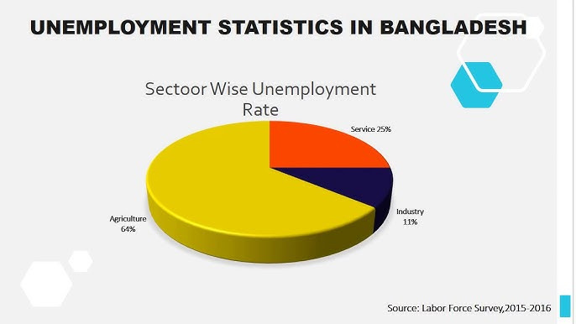


KormoShiri
THE PROBLEM IN BANGLADESH
"Experienced Fresher" Paradox
Companies demand experience, but students lack opportunities.
Disconnected Systems
Government skill programs (SEIP, NSDA) not integrated with tech platforms.
Accessibility Issues
Rural youth face language and tech barriers.
Industry Disconnect
University projects rarely align with market needs.

Slide 3
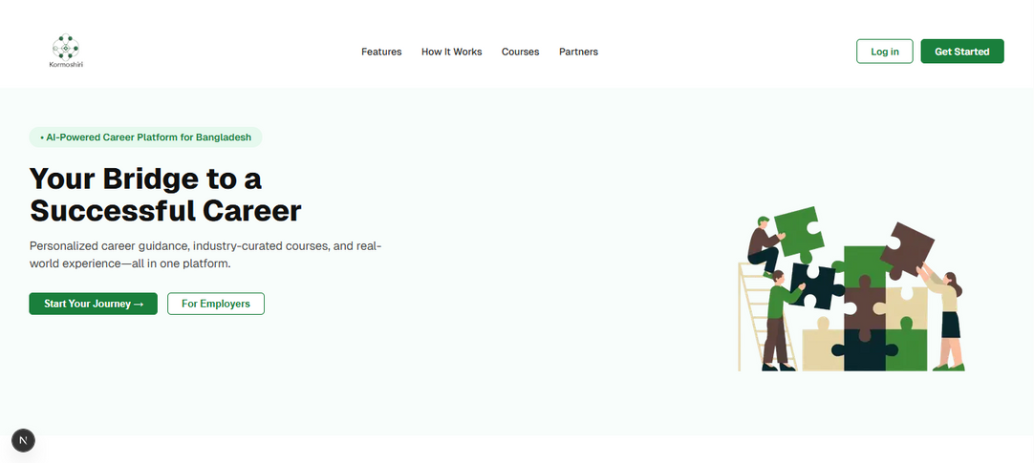
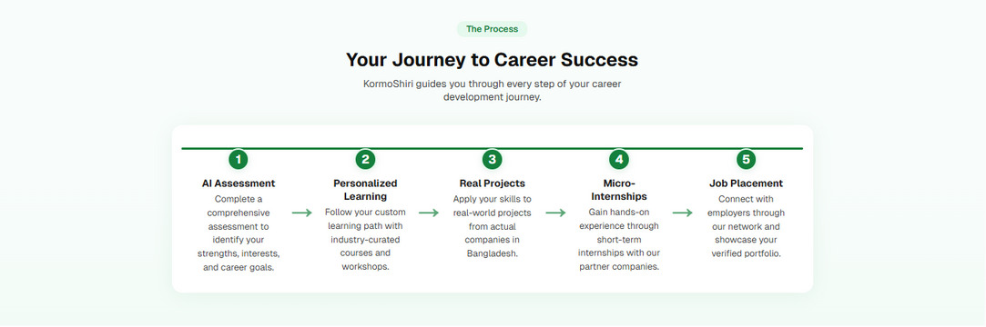
KormoShiri
INTRODUCING KORMOSHIRI
A tech-driven platform to empower Bangladeshi youth with skills, experience, and opportunities.
Mission: Bridge the gap between education, skills, and employability.
Target: Students, rural youth, and underserved communities.

Slide 4
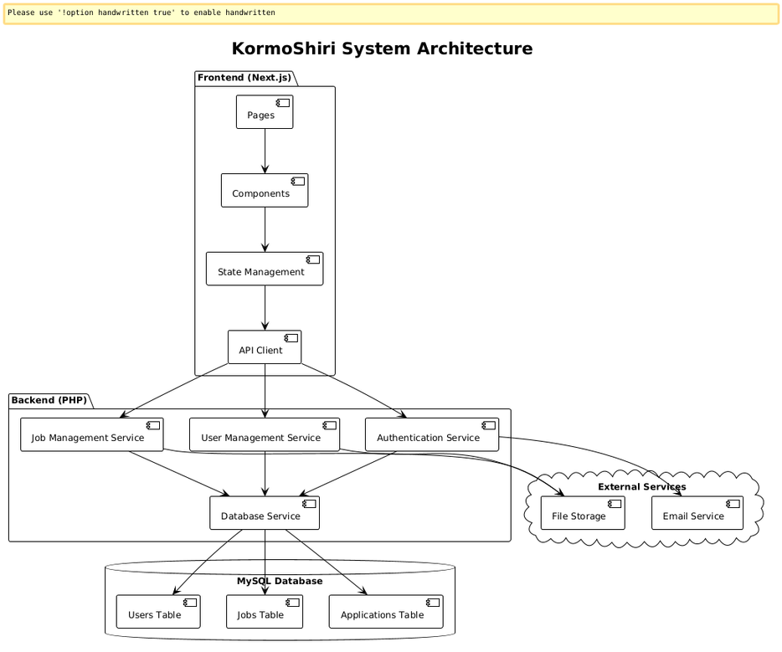
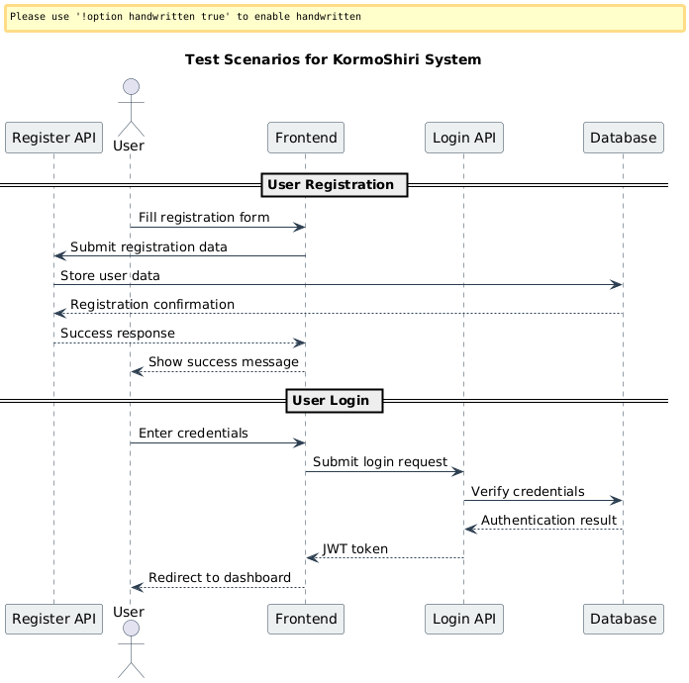
SYSTEM DESIGN
KormoShiri
Frontend: Next JS (Bangla/English, low-bandwidth mode).
Backend: Node JS MySql for scalable user and job data management.
AI/ML: Python-based model NLP and BNLP for localized career recommendations.
Blockchain: Ethereum smart contracts for secure skill certificates.
APIs: RESTful APIs for government (SEIP/NSDA) and payment (Nagad/bKash) integration.
Scalability: Cloud-hosted (AWS/GCP) with CDN for rural low-bandwidth access.
Impact: Robust, inclusive, and secure platform for millions of users.

Slide 5

KormoShiri
INNOVATION 1 - MICRO-INTERNSHIPS
Problem: No avenues for pre-graduation experience.
Solution: Structured micro-internships (1–4 weeks) with:
Startups, NGOs, MSMEs, local government.
Verified experience tokens for credibility.
Impact: Real-world experience for freshers.

Slide 6
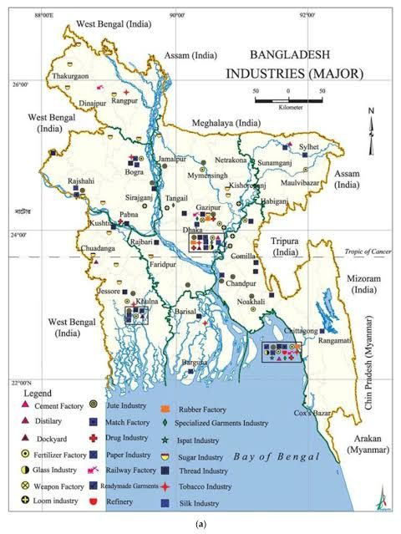
KormoShiri
INNOVATION 2 - LOCALIZED AI CAREER ROADMAPS
Problem: Global career paths don’t fit local job markets.
Solution: AI/ML model trained on local data (bdjobs, Prothom Alo, Chakri.com).
Examples: NGO tech officer, Upazila e-center manager, ecommerce admin.
Impact: Relevant, achievable career guidance.

Slide 7

KormoShiri
INNOVATION 3 - GOVERNMENT INTEGRATION
Problem: Government skills programs disconnected from tech platforms.
Solution: API-based integration for SEIP, NSDA, NTVQF.
Features: Digital validation of skills, career ladder progression.
Impact: Seamless skill recognition and employability.

Slide 8
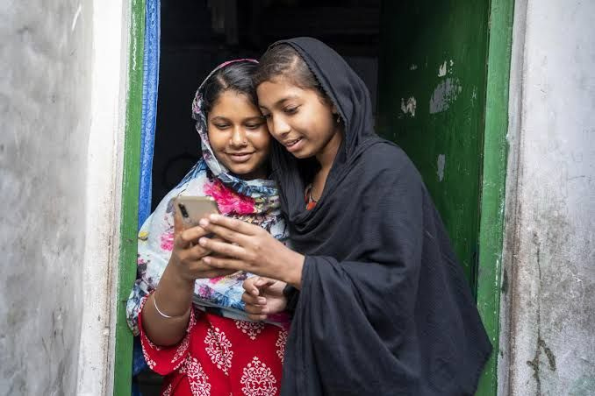
KormoShiri
INNOVATION 4 - RURAL & NON-ENGLISH INCLUSION
Problem:
Low English proficiency, poor tech access in rural areas.
Solution:
Dual-language (Bangla & English) interface.
Low-bandwidth mobile-optimized mode.
Bangla GPT for resume/interview feedback.
Local dialect support (Chittagong, Sylhet).
Impact: Inclusive access for all.

Slide 9

KormoShiri
INNOVATION 5 - UNIVERSITY-STARTUP INCUBATOR
Problem: University projects lack industry relevance.
Solution: Bridge between CS/Engineering departments and startups/NGOs.
Startups submit project ideas.
Students build MVPs with mentor guidance.
Top solutions get grants/internships.
Impact: Real innovation, job-ready skills.

Slide 10

KormoShiri
INNOVATION 6 - BLOCKCHAIN SKILL PASSPORT
Problem: Difficulty proving skills during job applications.
Solution: Blockchain-backed micro-certificates for:
Internships, projects, soft skills.
Decentralized, fraud-proof skill passport.
Impact: Trusted, verifiable credentials.

Slide 11
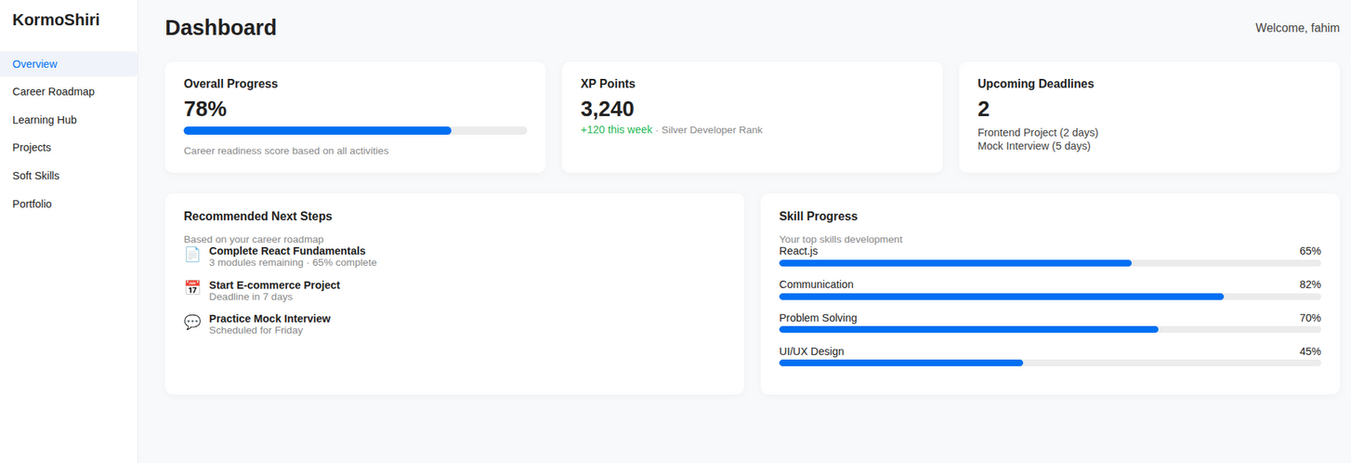
INNOVATION 7 - EARN & LEARN MODEL
KormoShiri
Problem:
Financial pressure halts skill-building.
Solution:
KormoX freelance micro-tasks (captioning, logo design, bug fixes).
Rewards: Credits to:
Unlock courses.
Pay for certifications.
Cash out via Nagad, bKash.
Impact:
Sustainable skill development.

Slide 12

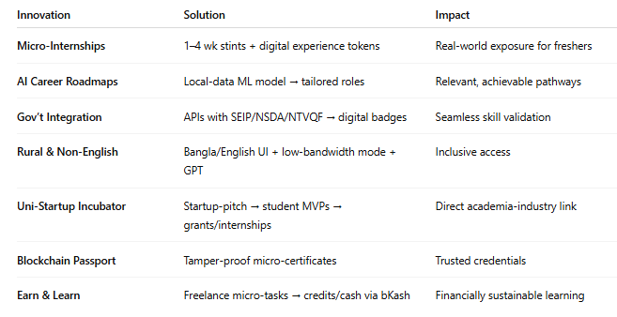
WHY KORMOSHIRI IS UNIQUE
KormoShiri
Micro-internships:
Not offered by any EdTech/JobTech platform
Localized AI roadmaps;
Uses local job data for relevant paths
Gov integration:
Bridges public-private skill validation
Rural inclusion:
Accessible to underserved youth
Blockchain passport:
Fraud-proof credentials
Startup incubator:
Ties academia to industry
Earn & learn:
Financially sustainable learning

Slide 13
KORMOSHIRI’S SUSTAINABLE BUSINESS MODEL
KormoShiri
Primary Revenue Streams:
Subscriptions:
Students: Premium (৳299-৳499/month) & Pro (৳799-৳999/month) for advanced assessments, counseling, certifications.
Employers: Business (৳5,000-৳10,000/month) & Enterprise (৳20,000-৳30,000/month) for talent search, analytics.
Placement Fees: 5-10% of first-month salary per hire, with discounts for bulk/educational partnerships.
Secondary Revenue Streams:
Educational Partnerships: Campus licenses (৳50,000-৳200,000/year) for universities.
Corporate Training: ৳5,000-৳15,000/participant for workshops, certifications.
Value-Added Services: Career services (৳1,000-৳5,000), skill programs (৳2,000-৳10,000).

Slide 14
TUTOR-DRIVEN BUSINESS MODEL
KormoShiri
Revenue Streams:
Commissions
Basic Tutor: 70% session, 60% group, 50% corporate fees.
Professional: 80% session, 70% group, 60% corporate fees.
Expert: 85% session, 75% group, 65% corporate fees.
Course Creation: 50-70% of course sales, subscriptions, corporate packages.
Resource Sales: 60-80% of resources, templates, premium content.
Business Model:
Tutors deliver skill development via sessions, courses, and resources.
Platform retains 15-50% of tutor earnings for operations.
Value Proposition:
For Tutors: High commissions, flexible earning opportunities.
For Students: Accessible, industry-aligned learning.

Slide 15

KormoShiri
IMPACT & VISION
Impact:
Empowered youth with skills and experience.
Inclusive opportunities for rural and underserved communities.
Stronger industry-academia-government synergy.
Vision:
A skilled, employable Bangladesh ready for the global economy.

Slide 16

KormoShiri
THANK YOU
FOR YOUR ATTENTION

